Slide 1

An Analysis of Eventstream Data
r/place 2023
Daniel Hill, Toby Guenthner, & Ryan Perez
Notes:
Ryan

Slide 2

Table of contents
01
02
03
04
03
r/place 2023
Objectives
The Data
An Overview
User Statistics and
Bot Complaints
Steps taken to conduct analysis
05
Key Findings
Conclusion
Key Statistics from r/place engagement and the impact of bots
Final takeaways
Notes:
Ryan

Slide 3
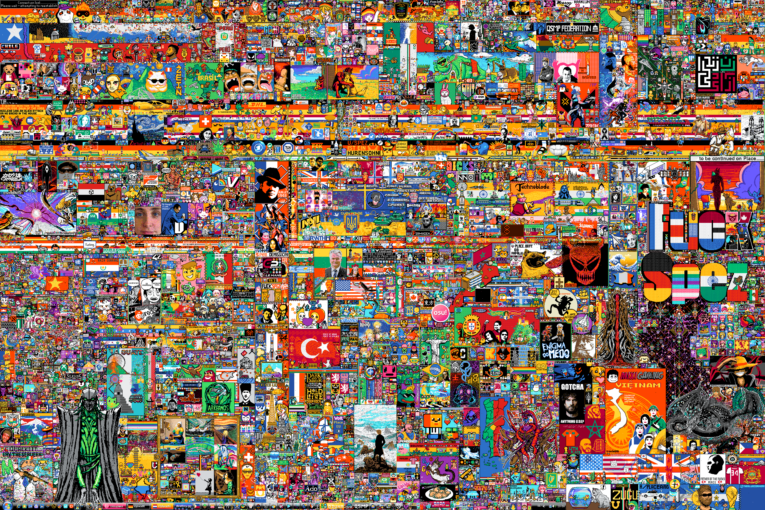
r/place 2023 Canvas
Notes:
Ryan

Slide 4
r/place 2023
A collaborative and interactive online art experiment hosted on Reddit
Users could place colored pixels on a blank canvas, contributing a massive shared piece of artwork
Canvas was initially a white grid
Users could place a pixel every five minutes
The result:
Wide variety of pixel art, memes, and patterns created from a collective effort (and bots...)
Notes:
Ryan

Slide 5
Objectives
From the data:
Create generally relevant statistics about r/place engagement
Analyze the impact of bots, including what artwork the bots most affected
Method: Look at highest active users' average time difference between pixel placement.

Slide 6
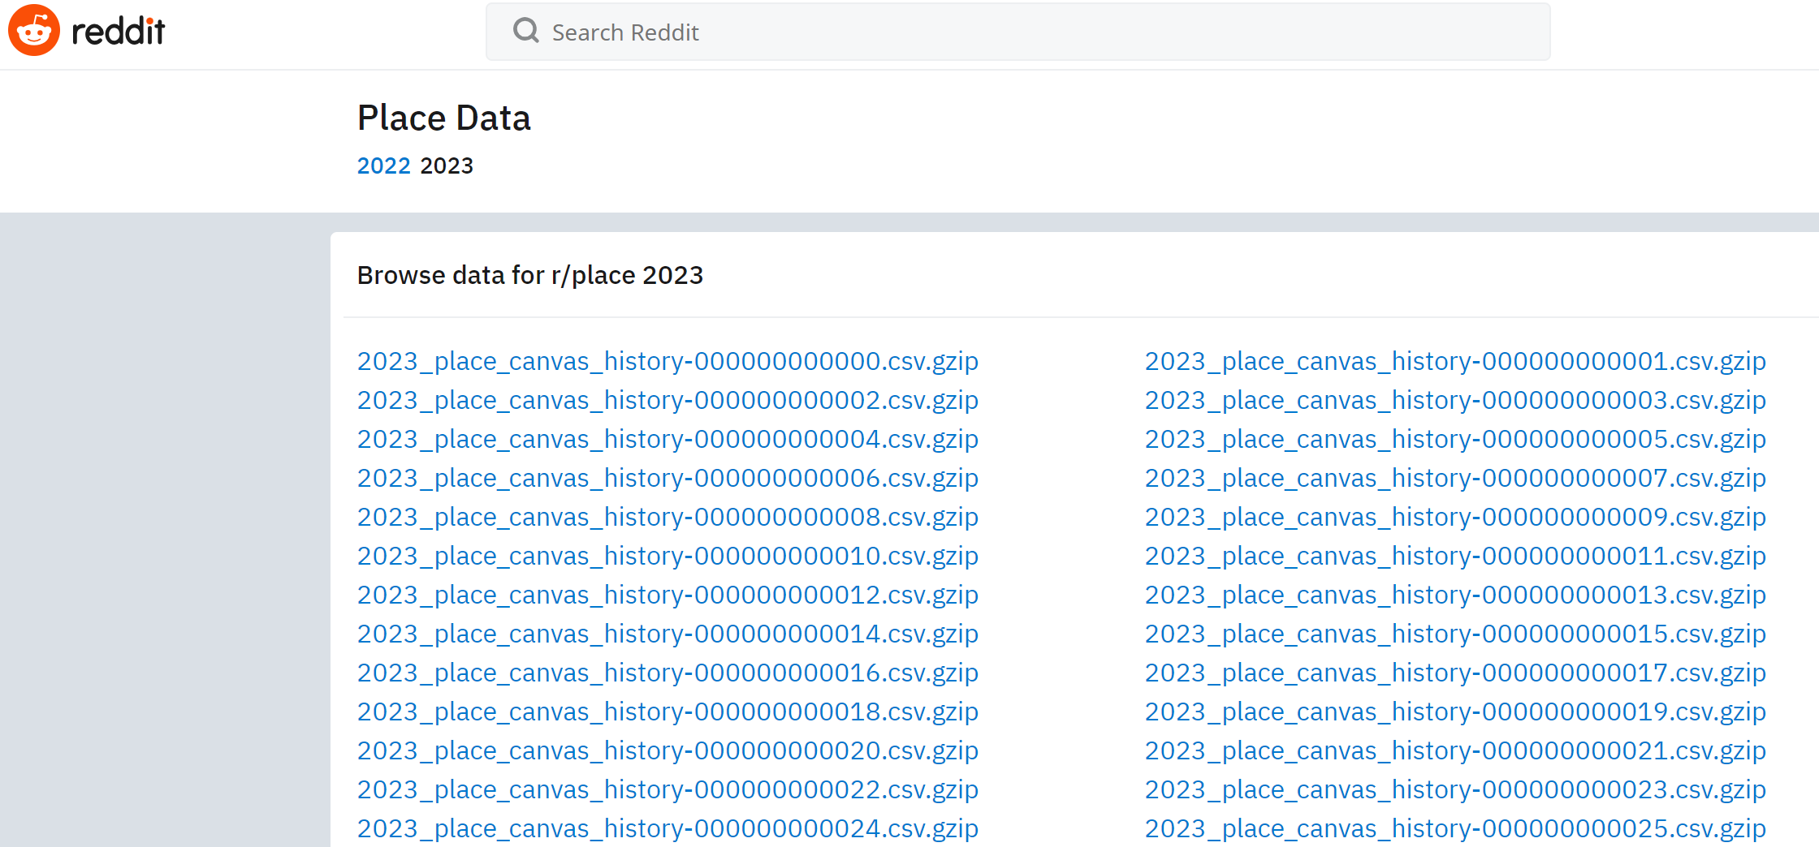
The Data
Data provided by Reddit on r/place
53 gzipped CSV files
Roughly 26 GB
~132 millions rows of data

Slide 7
Issues with Loading in the Data and our Solutions
Storing 26 GB on local computer
Solution: Cal Poly OneDrive – 1 TB
Unzipping by hand
Solution: Small Python script
Advantage: Minimal local storage
Disadvantage: Run time
Notes:
Daniel

Slide 8
Making the Data Smaller...
Libraries used:
Pandas and Polars
Data analysis and manipulation tools
Parquet
Columnar data file format
Makes data storage more efficient and reduces file sizes
Pyarrow
Library similar to Pandas, known for helping avoid keeping entire file in memory

Slide 9
Processing Problems
Daniel’s 8 GB Macbook
Couldn’t listen to music while running statistics
Successfully output single top modified pixel after 4 min.
Cores crashed after 8 minutes trying to group by users
Toby’s 32 GB PC
Better able to handle summary statistics
Group by’s worked for top 100 pixels and 1000 users

Slide 10
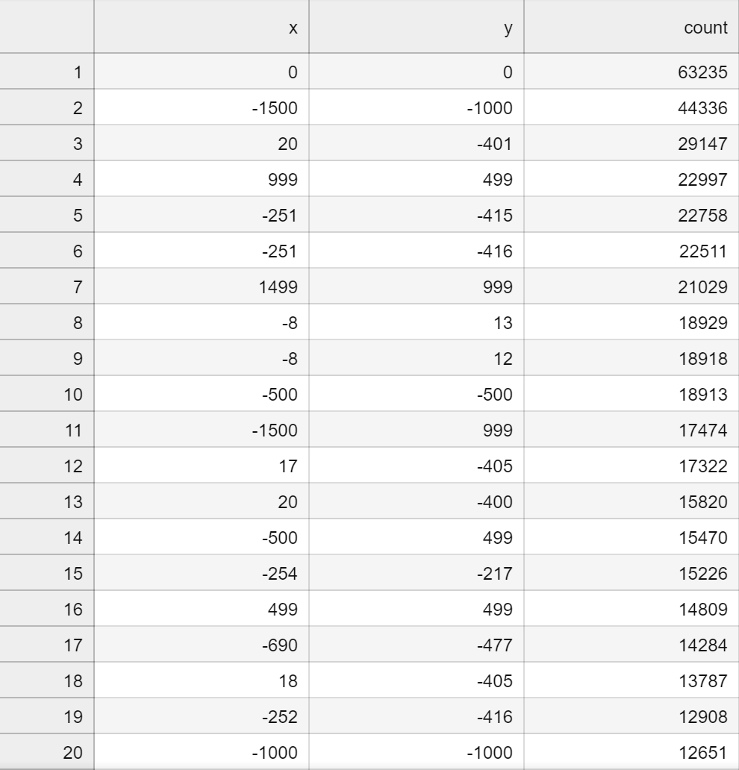
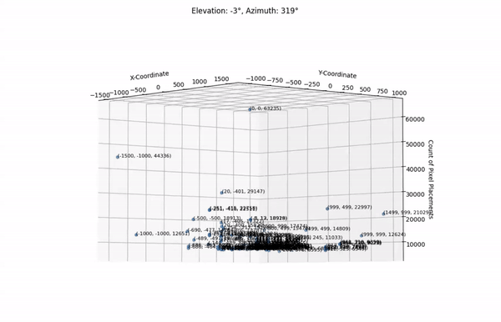
Group by top 100 edited pixels

Slide 11
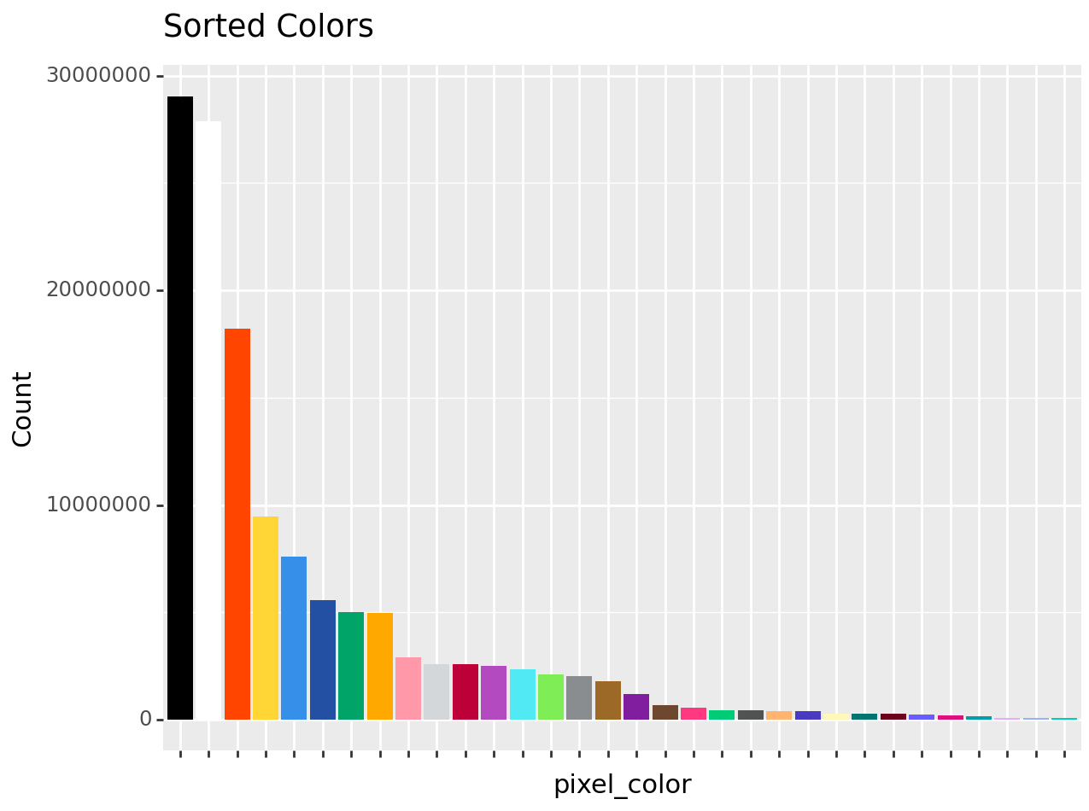

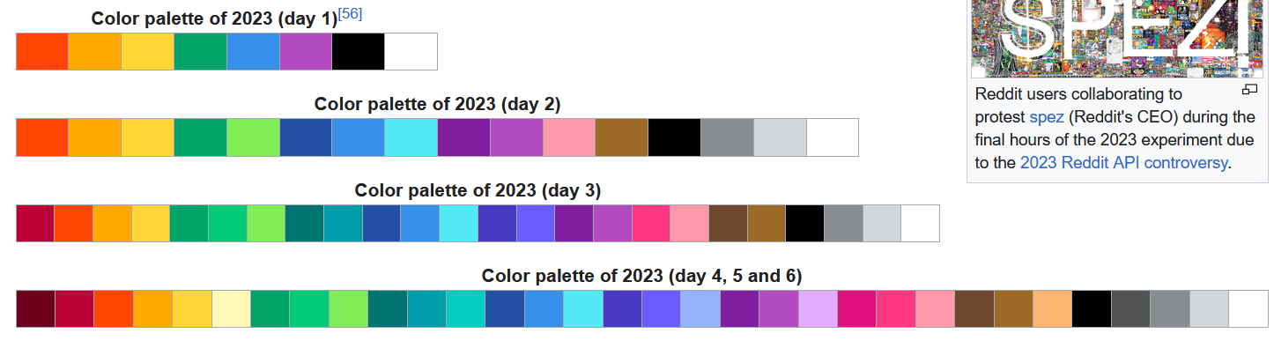
Group by top 32 hex colors

Slide 12
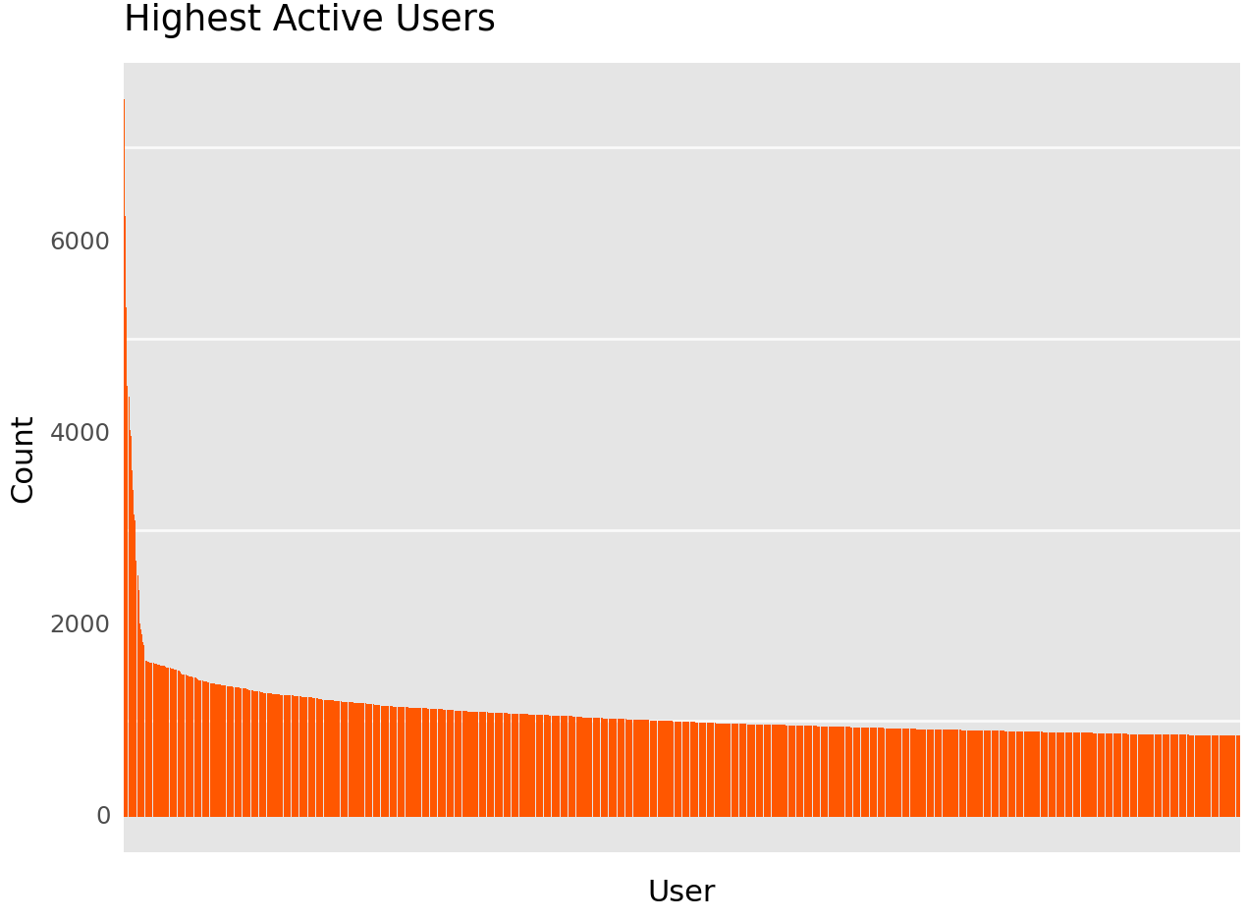
Group by Top 1000
Most Active Users

Slide 13
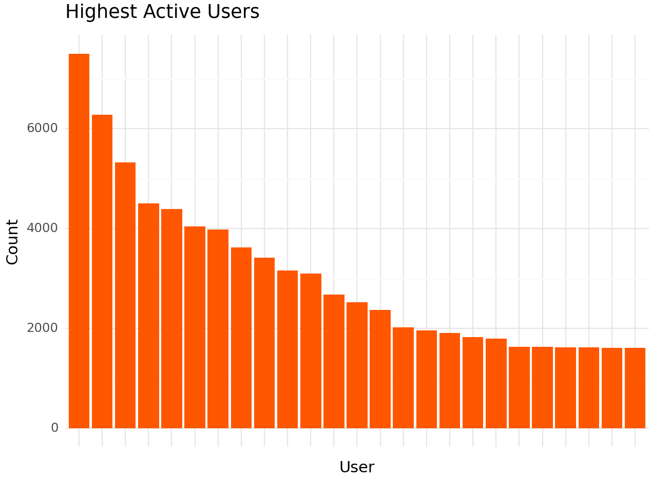
Cut down to Top 25 Most Active Users

Slide 14

Bots?

Slide 15
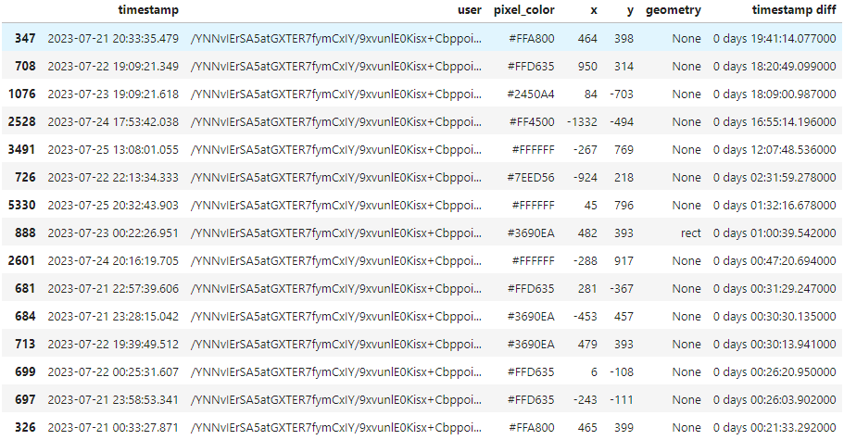
3rd most active user deep-dive
Mean: 1hr 21 Min
Median: 3 seconds

Slide 16
Botting service repository: https://github.com/michaelshumshum/r-placer
“bot that takes an input image, location, and account login to draw to the r/place canvas. .. Supports multiple accounts“
Account maker script w/ VPN to bypass timeouts per IP

Slide 17
Interactive Timelapse
https://place.ifies.com/2023/#x1861y811z1

Slide 18
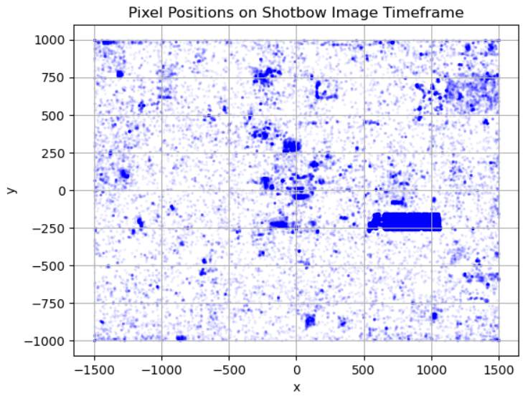
18:14:00 to 18:15:50
June 25th

Slide 19
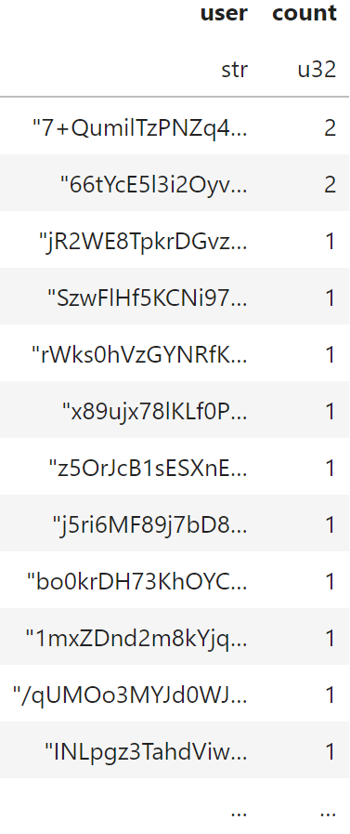
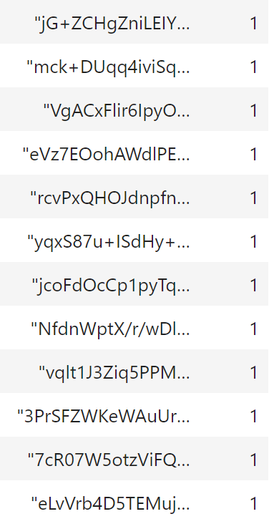
45910 ‘users’

Slide 20
Ladies and gentleman, we got him.

Slide 21
Conclusion
Final takeaways
Processing challenges
Dealing with larger files had an impact on data processing speed
Computing power limitations
Local computing power influenced processing speed and efficiency of analysis (not enough RAM)
Future considerations
Cloud Services
Higher memory solutions to process entire dataset all at once
Columnar storage format
Compress data even more by reducing the amount of memory taken up by User ID's

